Slide 1
Chapter 2 Objectives
The CCNA Topics Covered in this chapter include:
  Router Boot Sequence
  Different router modes
  Password configurations
  Configuring interfaces
  Significance of config-register
  IOS file system

Slide 2
Basic Router Configuration
The Cisco command-line interface (CLI) is used to configure

Slide 3
Router Power-On/Bootup Sequence
Router for the first time is configured through the CONSOLE port.COM port of a PC is connected to the console port of router with a console cable by using a transceiver. Router is accessible by a tool. In windows, it is called HYPER TEMINAL. As soon as the router is powered on and accessed, the following things happen,
POST ( Power on self test – checks hardware and all interfaces )
BOOT STRAP
ROM (mini IOS)
FLASH
NVRAM
Setup Mode

Slide 4
In Setup mode, there will be a message,
“Would You Like To Enter The Initial Configuration [Y/N]” :
If “Y” then, initial configuration starts.
If “N” would you like to terminate the auto installation?
Press “RETURN” to get started……You will land on the default prompt of the Router “ ROUTER >”.
Router>_

Slide 5
Working Modes Of a Router
User Mode (Default mode)
Privilege or Administrative Mode
Global Configuration Mode
Interface Configuration Mode
5. Line Configuration Mode
6. Router Mode
7. Sub-Interface Mode

Slide 6
USER MODE
Router> is the user mode, I,e the default prompt. It means that when ever a router boots successfully it lands into the user mode. Router cannot be configured from this mode, but it is used for just monitoring purpose.
Router> en
Router #

Slide 7
PREVILEGE MODE
Router# it is the administrating mode, we can check whether the settings and configurations made have been implemented or not.
Eg. “Router # sh int ethernet 0”.
If it is new router all the interfaces are by default shut down, so the message will be, “ Ethernet 0 is administratively down, line protocol is down.”

Slide 8
Global Configuration Mode
As the name indicates, it is a global configuration mode I,e. we can configure any interface from this mode, just by entering into the interface mode.
Router# Config terminal
Router (Config)#

Slide 9
The “Clock” Command
The clock command is used to set the clock of Router.
Syntax.
Router# clock set hh:mm:ss Day of week Month Year
E.g.
Router#clock set 12:55:00 19 April 2009
Note* This is the only configuration which can be done from privilege mode, every other configuration should be done at global configuration mode only.

Slide 10
Some of the important show commands in privilege mode
Router# sh clock
sh int (interface name eg eth0)
sh history
sh memory
sh running-config
sh startup-config

Slide 11
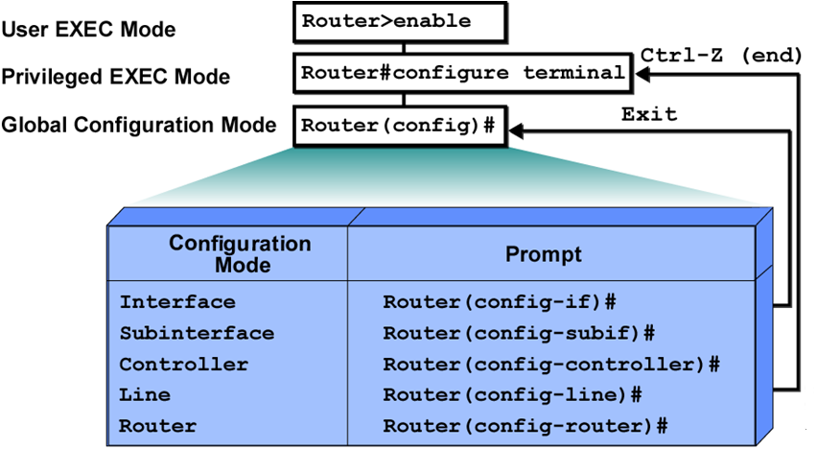
Overview of Router Modes

Slide 12
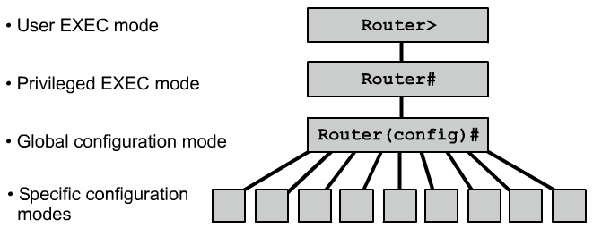

Slide 13
To configure Hostname (or) Identification of Router over the network.
Router#conf t
Router(config)#hostname Silicon
Silicon(config)#^Z
A message-of-the-day (MOTD) banner can be displayed on all connected terminals.
To configure Logging banner.
Router#conf t
Router(config)#banner motd #
Enter text message………….#
Router(config)#^Z

Slide 14
show running-config and show startup-config Commands
In RAM
In NVRAM
Silicon#show running-config
Building configuration...
Current configuration:
!
version 12.0
!
-- More --
wg_ro_c#show startup-config
Using 1359 out of 32762 bytes
!
version 12.0
!
-- More --
To save configuration from RAM TO NVRAM
Router#copy running-config startup-config
(or)
Router#write memory

Slide 15
Router Password Configuration
Privilege Password
Virtual Terminal Password
Console Password
Auxillary Password

Slide 16
Privilege PASSWORDS
Enable Password
Enable Secret
Enable Password:- It is global command restricts access to the privilege mode, the password is in clear text.
Router(config)#enable password abc
Enable Secret:-Here the password is in encrypted form.
Router(config)#enable secret silicon

Slide 17
Virtual Terminal Password
It establishes a login password on incoming Telnet sessions.
A password must be set on one or more of the virtual terminal (VTY) lines for users to gain remote access to the router using Telnet.
Typically Cisco routers support five VTY lines numbered 0 through 4.
Router#conf t
Router(config)#line vty 0 4
Router(config-line)#password silicon
Router(config-line)#login
Router(config-line)#^Z

Slide 18
Telnet password – line vty
RouterA>telnet 10.1.1.1
Trying 10.1.1.1 ... Open
Password required, but none set
[Connection to 10.1.1.1 closed by foreign host]
RouterA>
RouterA>telnet 10.1.1.1
Trying 10.1.1.1 ... Open
User Access Verification
Password:cisco
RouterB>
RouterB>exit
[Connection to 10.1.1.1 closed by foreign host]
RouterA>
RouterB(config)#line vty 0 4
RouterB(config-line)#login
RouterB(config-line)#password cisco
Configure vty password on RouterB
Telnet works! Enter vty password
Exit closes (ends) telnet session
You must have the vty password set on the remote routers.
We will always use vtypass as our vty passwords!

Slide 19
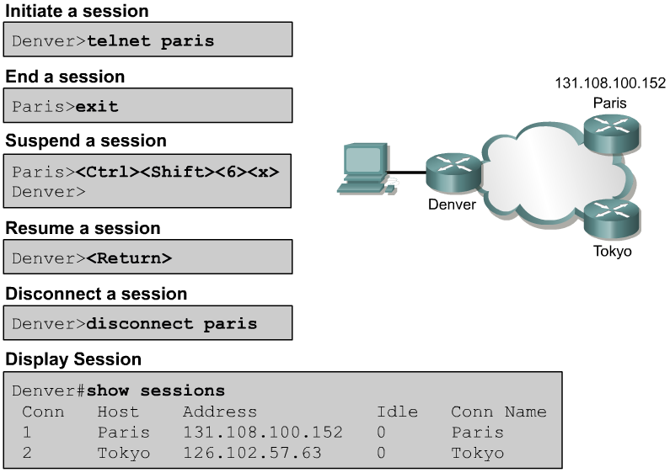
Disconnecting and suspending Telnet sessions
A session is suspended for a limited time, to resume a Telnet session that has been suspended, just press Enter.
The command show sessions will show what Telnet sessions are taking place.

Slide 20
Checking Telnet Connections
    Router#sh sessions
Checking Telnet Users
    Router#sh users
Closing Telnet Sessions
    RouterB>exit
    RouterB>disconnect

Slide 21
Console Password
It establishes a login password on the console terminal.
Router#conf t
Router(config)#line console 0
Router(config-line)#password silicon
Router(config-line)#login
Router(config-line)#^Z

Slide 22
Auxillary Password
It establishes a login password to remote administration.
Router#conf t
Router(config)#line aux 0
Router(config-line)#password silicon
Router(config-line)#login
Router(config-line)#^Z

Slide 23
Encrypting Passwords
Only the enable secret password is encrypted by default
To manually encrypt your passwords, use the service password-encryption command.
Here’s an example of how to do it:
silicon#config t
Enter configuration commands, one per line. End with CNTL/Z.
silicon(config)#service password-encryption
silicon(config)#exit

Slide 24
CONFIGURING INTERFACES
LAN interface (ETHERNET Port)
Router(config)#interface ethernet 0
Router(config-if)#ip address 20.15.1.25 255.255.255.0
Router(config-if)#no shutdown
Router(config-if)#^Z
Router#show int E0
WAN interface (SERIAL Port)
Router(config)#interface Serial 0
Router(config-if)#ip address 15.10.1.1 255.255.0.0
Router(config)#clock rate 56000
Router(Config-if)# bandwidth 64
Router(config-if)#no shutdown
Router(config-if)#^Z

Slide 25
Interpretring The Interface Status
Router# show int s0
Serial0 is up, line protocol is up. Is the messege if the interface is operational.
Serial0 is up, line protocol is down….. This is if there is any connection problem.
Serial0 is down, line protocol is down….. This is if there is any interface problem.
Serial0 is administratively down, line protocol is down….. This is if the interface is disabled.

Slide 26
Checking the Register Value
Gateway-Router>show version
Cisco Internetwork Operating System Software
IOS (tm) C2600 Software (C2600-DO3S-M), Version 12.0(5)T1, RELEASE SOFTWARE (fc1)
Copyright (c) 1986-1999 by cisco Systems, Inc.
Compiled Tue 17-Aug-99 13:18 by cmong
Image text-base: 0x80008088, data-base: 0x80CB67B0
ROM: System Bootstrap, Version 11.3(2)XA4, RELEASE SOFTWARE (fc1)
NoSmo-Gateway uptime is 5 weeks, 3 days, 20 hours, 33 minutes
System returned to ROM by power-on
System restarted at 13:30:22 PST Thu Mar 7 2002
System image file is "flash:c2600-do3s-mz.120-5.T1"
cisco 2621 (MPC860) processor (revision 0x102) with 39936K/9216K bytes of memory.
Processor board ID JAB03520113 (2485375272)
M860 processor: part number 0, mask 49
Bridging software.
X.25 software, Version 3.0.0.
2 FastEthernet/IEEE 802.3 interface(s)
4 Serial(sync/async) network interface(s)
32K bytes of non-volatile configuration memory.
--More—
Configuration register is 0x2102
Gateway-Router>
IOS source
configuration register

Slide 27
Changing the Configuration Register
Router(config)#config-register 0x0101
Router(config)#^Z
Router#sh ver
Configuration register is 0x2102 (will be 0x0101 at next reload)
The Configuration Register Bit Numbers
Configuration Register 2 1 0 2
Bit number 15 14 13 12 11 10 9 8 7 6 5 4 3 2 1 0
Binary 0 0 1 0 0 0 0 1 0 0 0 0 0 0 1 0
Notice that bit 6 can be used to ignore the NVRAM contents.
This bit is used for password recovery.

Slide 28
Recovering Passwords
1. Boot the router & interrupt the boot sequence by performing a break
2. Change the configuration register to turn on bit 6 (0x2142)
3. Reload the router
4. Enter the privileged mode
5. Copy the startup-config to running-config
6. Change the password
7. Reset the configuration register to the default value
8. Reload the router

Slide 29
1: Boot the router & interrupt the boot sequence by performing a break using the Ctrl+Break key combination.
2: Change the configuration register to turn on bit 6 (0x2142)
  rommon>confreg 0x2142
  You must reset or power cycle for new config to take effect
3: Reload the router
  Type reset
    The router will reload & ask if you want to enter setup mode
      Answer NO
4: Enter the privileged mode
    Router>enable
    Router#

Slide 30
5: Copy the startup-config to running-config
    Router#copy startup-config running-config
6: Change the password
    Router#config t
    Router(config)#enable secret silicon
7: Reset the configuration register to the default value
    Router(config)#config-register 0x2102
8: Reload the router

Slide 31
Backing up an IOS image
copy flash tftp
Make sure that tftp server is reachable.
Router# copy flash tftp
Source filename []? c3640-js-mz.120-11
Address or name of remote host []? 192.168.1.1
Destination filename [c3640-js-mz.120-11]?
!!!!!!!!!!!!!!!!!!!!!!!!!!!!!!!!!!!!!!!!!!!!!!!!!!!!!!!!!!!!
!!!!!!!!!!!!!!!!!!!!!!!!!!!!!!!!!!!!!!!!!!!!!!!!!!!!!!!!!!!!
<--output omitted-->
6754416 bytes copied in 64.452 secs (105537 bytes/sec)
Router#

Slide 32
Loading an IOS image
- copy tftp flash
Router# copy tftp flash
Address or name of remote host []? 192.168.1.1
Source filename []? c3640-js-mz.120-7
Destination filename [c3640-js-mz.120-7]?
Loading c3640-js-mz.120-7 from 192.168.1.1 (via FastEthernet0/0):
!!!!!!!!!!!!!!!!!!!!!!!!!!!!!!!!!!!!!!!!!!!!!!!!!!!!!!!!!!!
!!!!!!!!!!!!!!!!!!!!!!!!!!!!!!!!!!!!!!!!!!!!!!!!!!!!!!!!!!!
<--output omitted-->
[OK - 6754416/13508608 bytes]
Verifying checksum... OK (0xCAF2)
6754416 bytes copied in 66.968 secs (102339 bytes/sec)
Router#

Slide 33
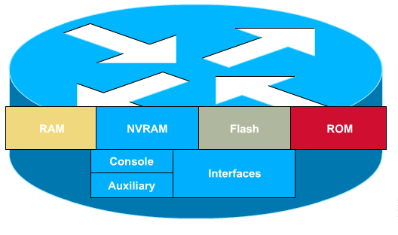
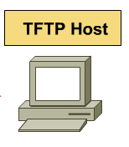
Cisco IOS File System (IFS)
copy from-file to-file
system:
nvram:
flash:
running-config
RAM
IOS (running)
startup-config
IOS
ios
copy flash:<filename> tftp:
copy tftp: flash:<filename>
copy tftp: nvram:startup-config
copy nvram:startup-config tftp:
copy tftp: system:running-config
copy system:running-config tftp:

